Slide 1
3047 Avenue U, Brooklyn, NY 11229, | 888-WCHEXPERTS | www.wchsb.com

Slide 2
FIDA
FIDA AFFECTS EVERY SPECIALTY
NEW YORK PROVIDER
Counties Affected: Bronx, Kings, Nassau, New York, Queens, Richmond, Suffolk or Westchester
3047 Avenue U, Brooklyn, NY 11229, | 888-WCHEXPERTS | www.wchsb.com

Slide 3
Who is eligible for FIDA?
Reside in one of eight counties: Bronx, Kings, Nassau, New York, Queens, Richmond, Suffolk or Westchester;
Age 21 or older at the time of enrollment;
• Entitled to benefits under Medicare Part A and enrolled in Medicare Part B and eligible to enroll in Part D, and receiving full Medicaid benefits;
• Individuals must also meet one of the two following criteria:
i. Require community-based long term care services for more than 120 days.
ii. Be eligible for but not already receiving facility-based or community-based LTSS (“New to Service”).
3047 Avenue U, Brooklyn, NY 11229, | 888-WCHEXPERTS | www.wchsb.com

Slide 4
Some individuals are eligible to sign up for a FIDA Plan but will not be passively enrolled. In particular, some groups of people will not be passively enrolled but are eligible to opt-in, including but not limited to: Native Americans, PACE program enrollees, enrollees in a Medicare Advantage Special Needs Plan for institutionalized individuals, individuals participating in the CMS Independence at Home demonstration, enrollees in Employer or Union Sponsored coverage for employees or retirees, enrollees in a Health Home, individuals with coverage mandated by the Aliessa federal court decision, individuals eligible for the Medicaid coverage buy-in for working disabled, and individuals who are eligible for the Nursing Home Transition & Diversion (NHTD) 1915(c) waiver.

Slide 5
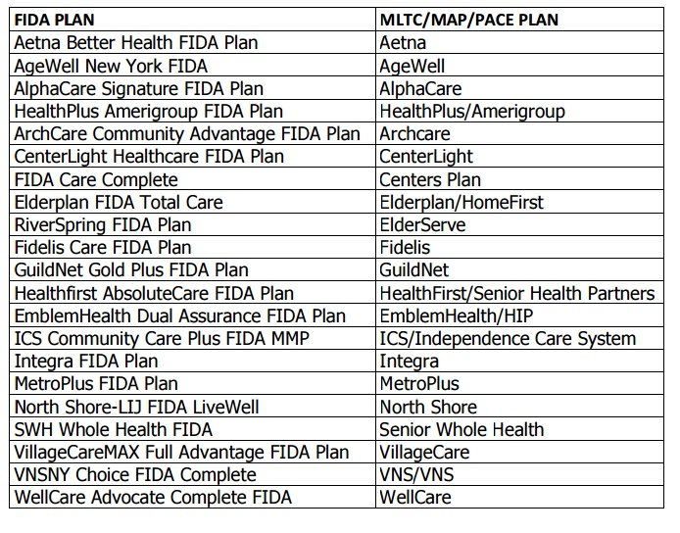

Slide 6
Can I continue to see my patients who join a FIDA Plan even if I’m not participating?
Yes, for a limited amount of time (and possibly longer for patients whose care team or FIDA Plan has authorized their continuing to see you as an Out-Of-Network provider)
All participants new to a FIDA Plan will have a transition period during which they can continue a current course of treatment with their existing provider. The transition period will last for ninety (90) days from the time of enrollment or until the FIDA Plan participant’s Person-Centered Service Plan is finalized and implemented, whichever is later. During the transition period, participants can maintain existing providers they’ve seen in the past 6 months, regardless of whether those providers are in the FIDA Plan's network. The FIDA Plan must make reasonable efforts to bring these providers into the FIDA Plan network
3047 Avenue U, Brooklyn, NY 11229, | 888-WCHEXPERTS | www.wchsb.com

Slide 7
If the participant is receiving services from a behavioral health provider at the time of his/her enrollment, he/she may continue to get services from that provider until treatment is complete, but not for more than two years. This is the case even if the provider does not participate in FIDA Plan’s network. The FIDA Plan will receive payment for these services at least at the applicable Medicaid fee for service rate
Please note: If a participant needs to get services from you and you are an out-of-network provider, he/she must work with their FIDA Plan or IDT to get approval to see an out-of-network provider. If he/she goes to an out-of-network provider without first getting Plan or IDT approval, he/she may have to pay the full cost of the services
3047 Avenue U, Brooklyn, NY 11229, | 888-WCHEXPERTS | www.wchsb.com

Slide 8
How it affects Providers in New York?
Practices that only have MCB/MED patients that are receiving homecare services will be switched to FIDA plans if the doctors don’t participate with plans they lose income. So practices that have online Medicare and Medicaid enrollment cannot see these patients.
Patients can refuse enrollment and be returned back to original plans. Provider offices must facilitate this change.
2. FIDA plans pay better than Medicare and there is no more secondary payer. FIDA becomes their one plan. FIDA pays 90-100% rate on claims but has like any other insurance authorization process and benefit limit.
3. Future plans of FIDA – Coordinate services for these patients in full. All services will be approved by RN or NP for each patient and will require authorization. Case worker will handle services for these patients.
3047 Avenue U, Brooklyn, NY 11229, | 888-WCHEXPERTS | www.wchsb.com

Slide 9
How it affects WCH?
At least 20 practices that we have are operating only with Medicare and Medicaid enrollment , they don’t have any other insurance which FIDA joined. If the patients don’t decline FIDA these providers cannot see them, unless providers enroll. Takes time panels could be closed.
Service Solution: Credentialing
We will be creating FIDA Package credentialing for all providers in NY. Starting marketing it now.
Webinar:
I did not see any other company yet train providers in NY about FIDA impact. I want to create webinar 30 min once a week for NY providers for $59.99 to provide this education.
2. Billing and our payment process will also change for us. Still new FIDA Plans don’t all have EDI interchange set up. Unlike with Medicare and Medicaid claims payments will be coming later from payers. Some payers primary claims will need to sent on paper.
3047 Avenue U, Brooklyn, NY 11229, | 888-WCHEXPERTS | www.wchsb.com

Slide 10
How it affects WCH?
3. Account representatives educate own clients
4. New Client search strategy:
Concentrate on clients with younger than 65 age population
Sign clients that participate with plan, credentialing is unavoidable now.
Sign facility clients like urgent cares , facility base providers
Pursue other states
3047 Avenue U, Brooklyn, NY 11229, | 888-WCHEXPERTS | www.wchsb.com

Slide 11
Resources for help
https://www.cms.gov/Medicare-Medicaid-Coordination/Medicare-and-Medicaid-Coordination/Medicare-Medicaid-Coordination-Office/FinancialAlignmentInitiative/Downloads/NYProviderFAQ.pdf
http://www.wnylc.com/health/download/429
3047 Avenue U, Brooklyn, NY 11229, | 888-WCHEXPERTS | www.wchsb.com

